Slide 1

En Sevdiğim Defterim ‘Jupyter’ :)
Gönül Aycı
ÖYLG
12 Mayıs 2019

Slide 2
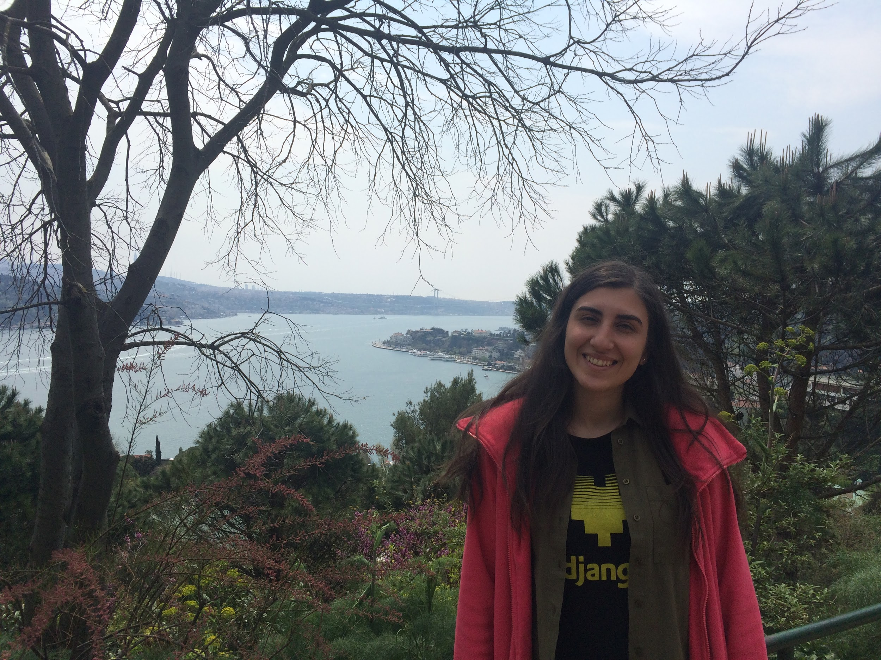





Gönül Aycı - Bogazici University

Slide 3
Agenda
What is Jupyter Notebook?
How Jupyter Notebook works?
What is Word2Vec?
Twitter API example
Pandas Dataframe example
Gönül Aycı - Bogazici University

Slide 4

What is Jupyter Notebook?
Gönül Aycı - Bogazici University

Slide 5
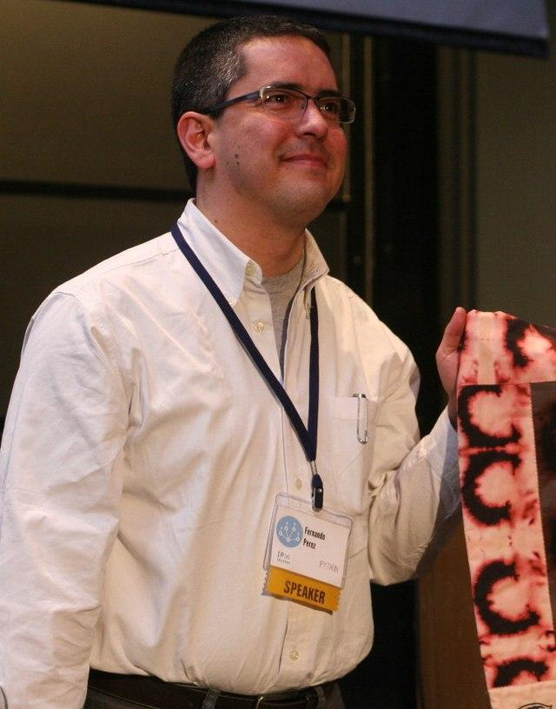
Fernando Pérez
IPython → Jupyter Notebook
2001 → 2014
Jupyter Notebook
Interactive and shareable notebooks
Live code
Equations
Visualizations
Narrative text
Gönül Aycı - Bogazici University
Notes:
The Jupyter Notebook is an open-source web application that allows you to create and share documents that contain live code, equations, visualizations and narrative text. Uses include: data cleaning and transformation, numerical simulation, statistical modeling, data visualization, machine learning, and much more.

Slide 6



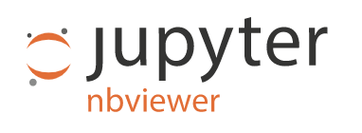
Jupyter Notebook
Gönül Aycı - Bogazici University

Slide 7
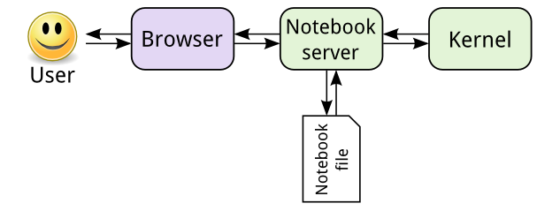
How Jupyter Notebook works?
Gönül Aycı - Bogazici University

Slide 8

DEMO: Jupyter Notebook
Gönül Aycı - Bogazici University

Slide 9
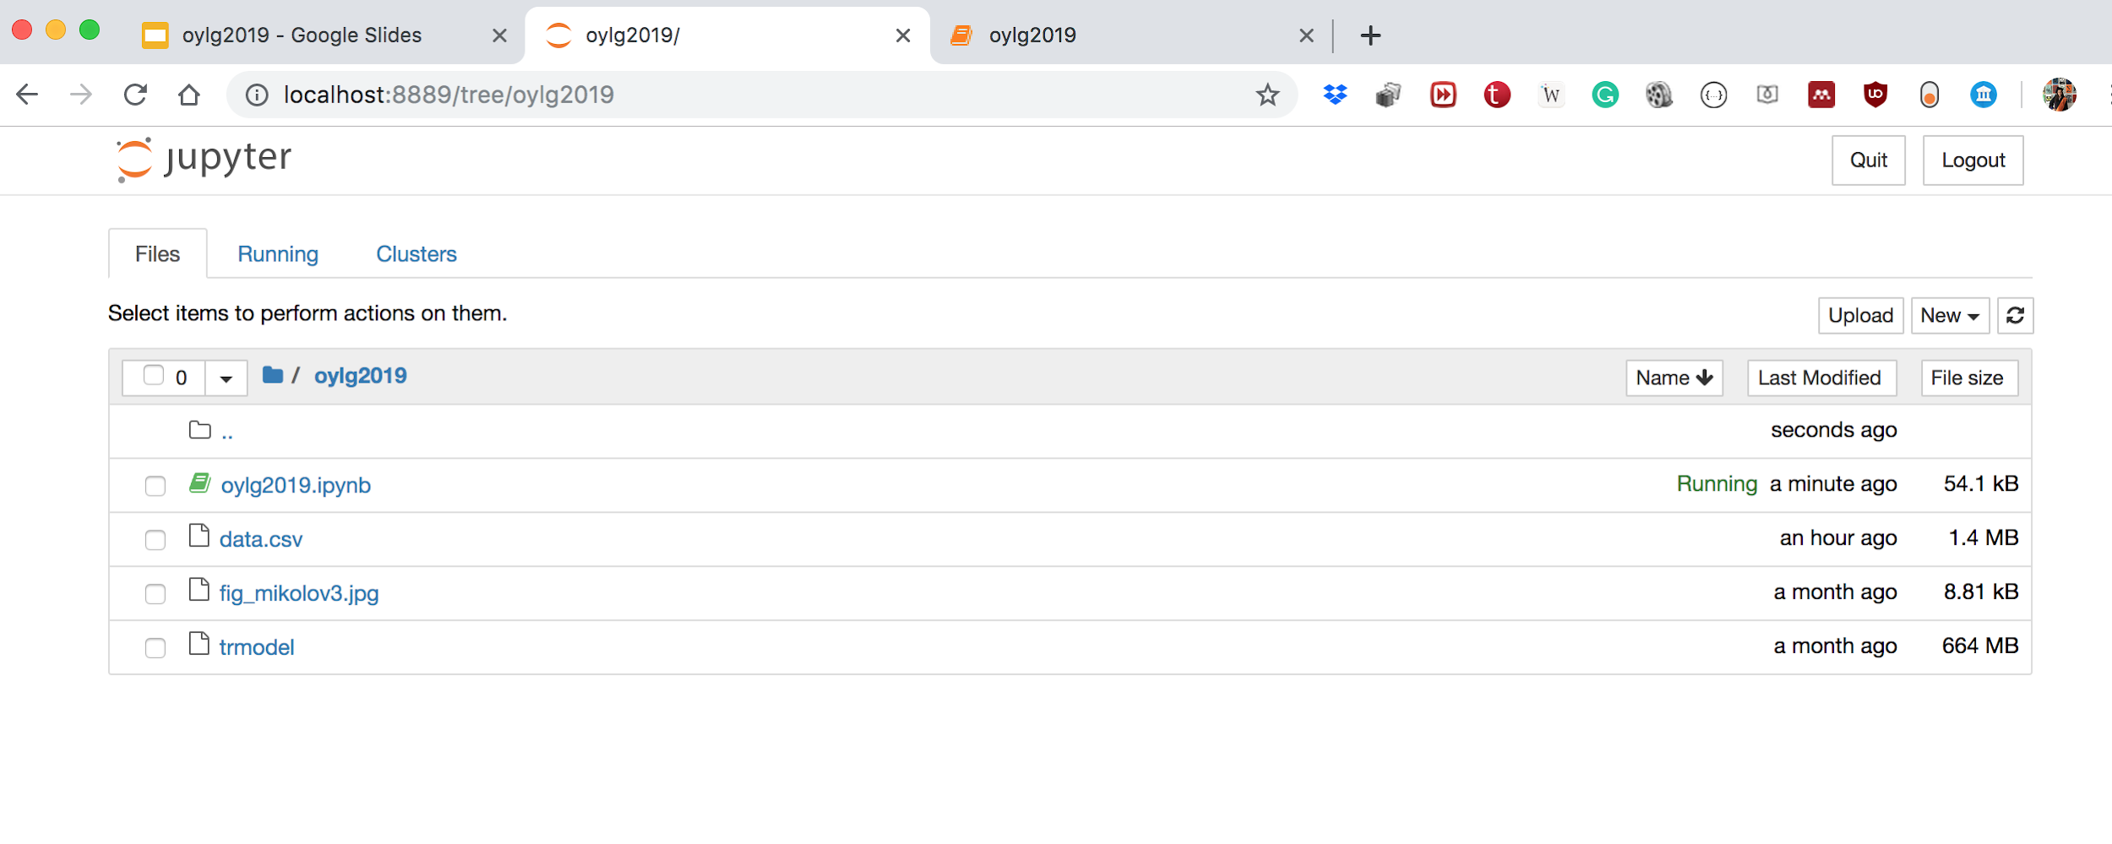

Slide 10
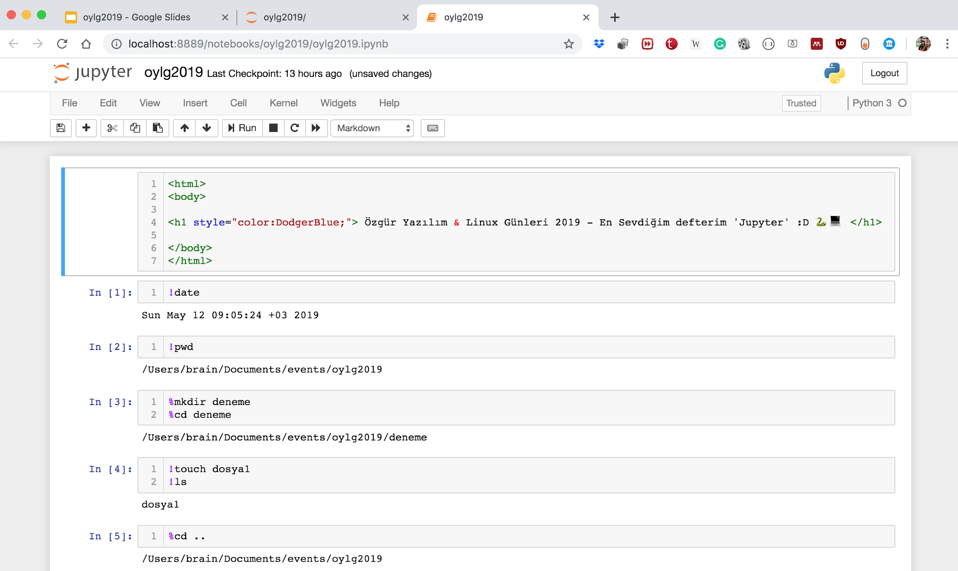

Slide 11
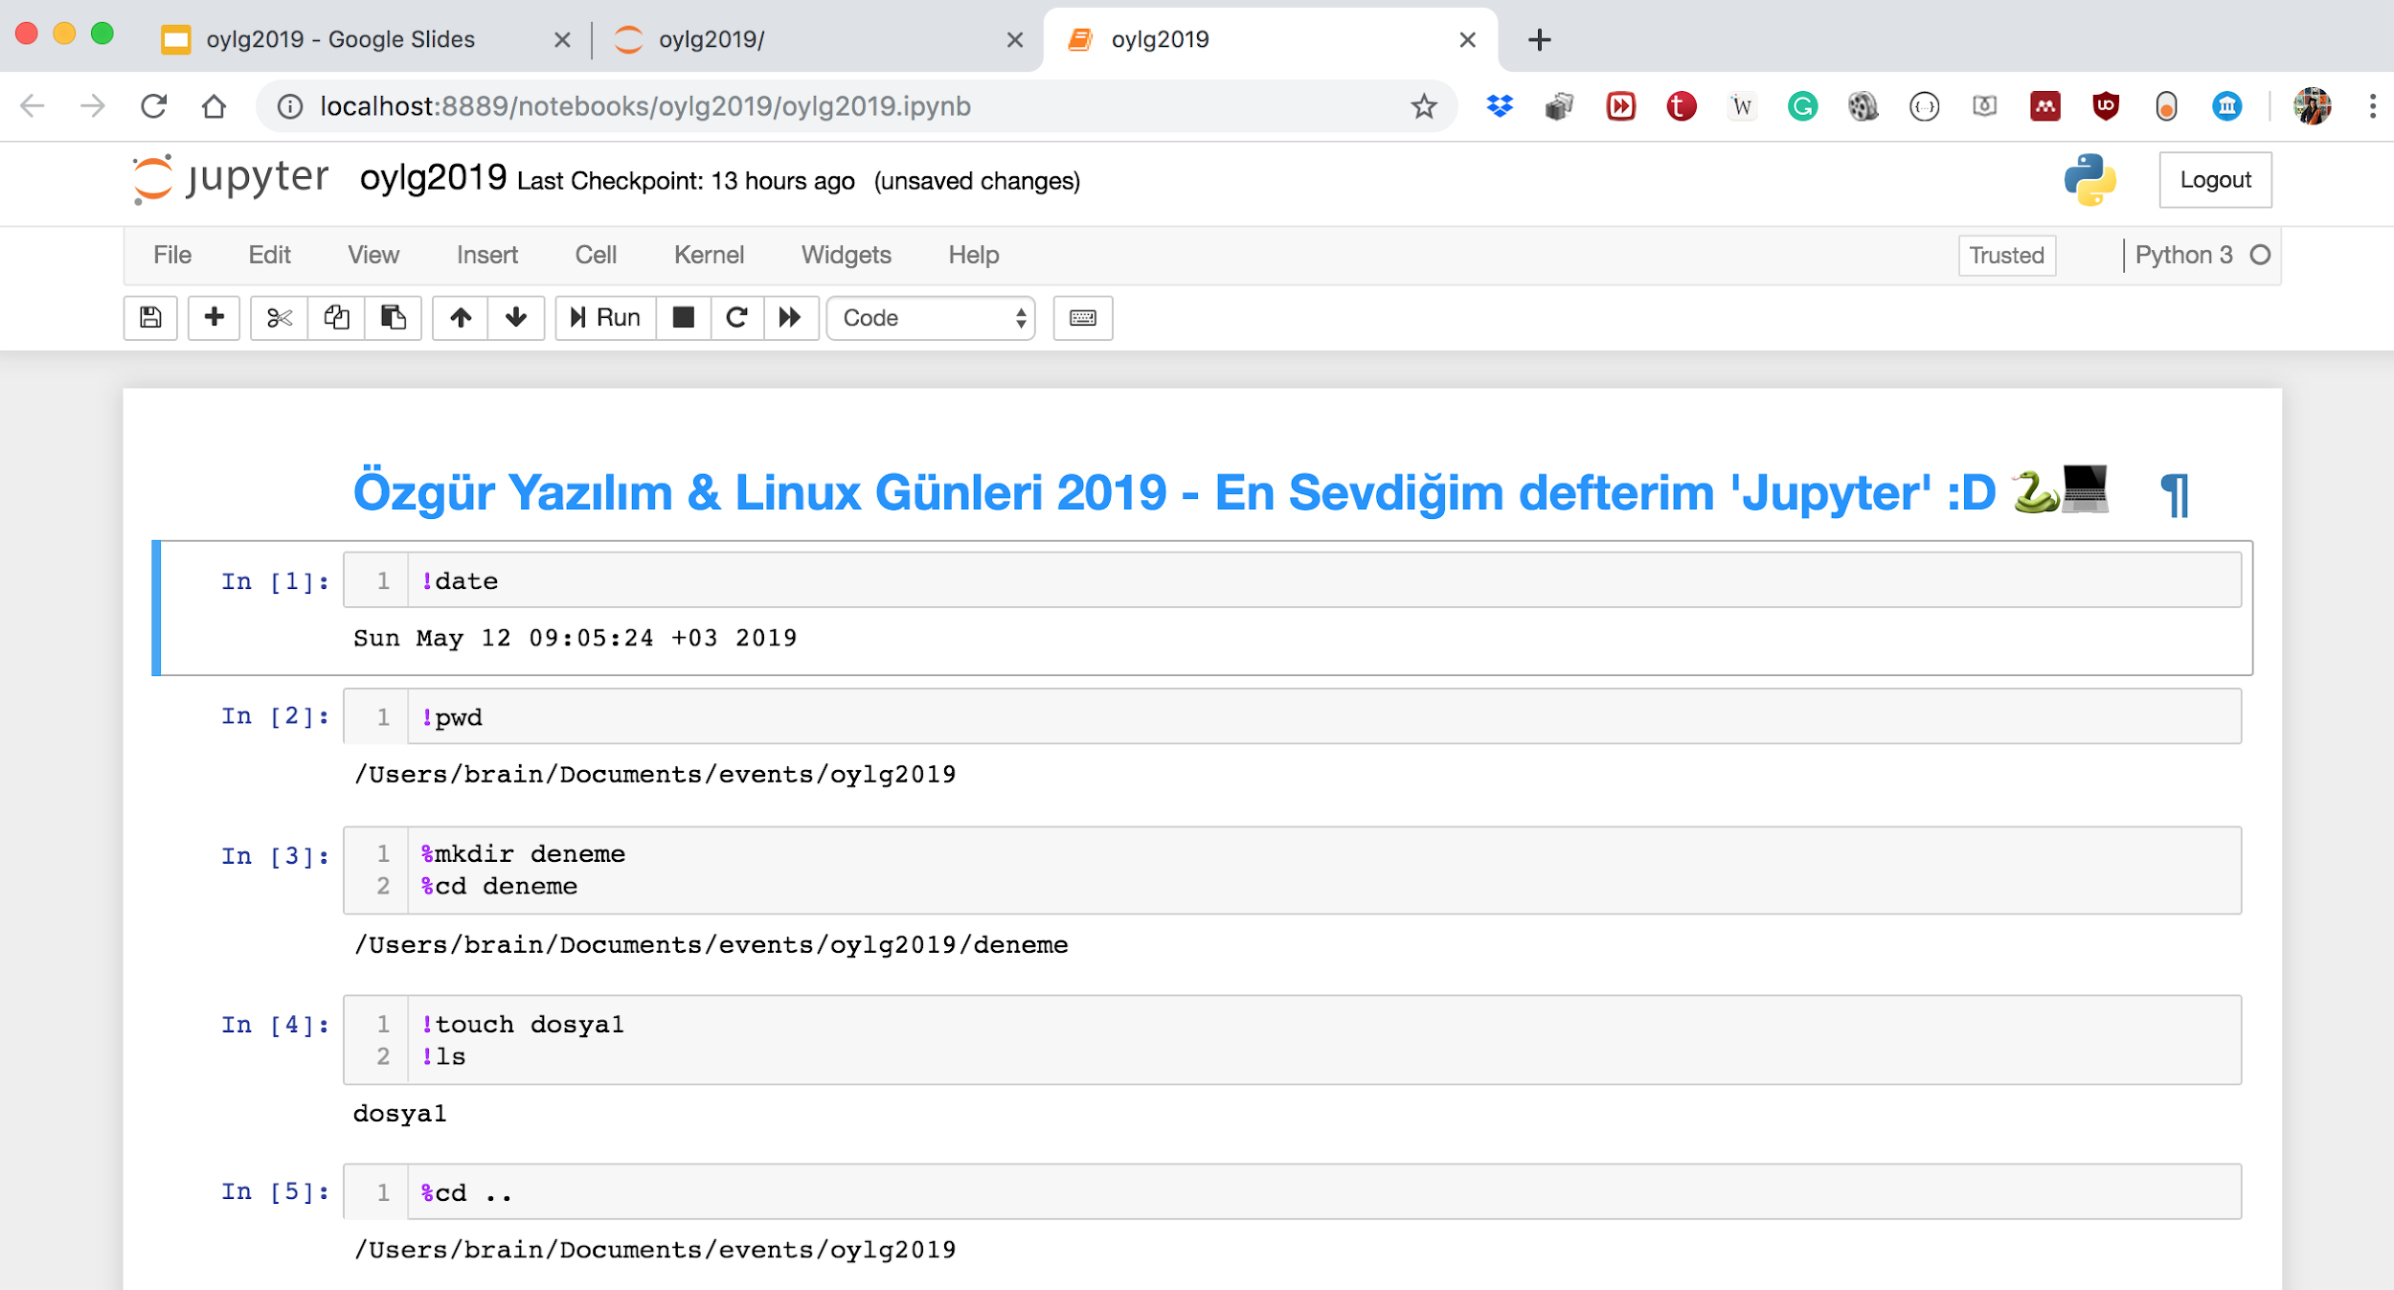

Slide 12
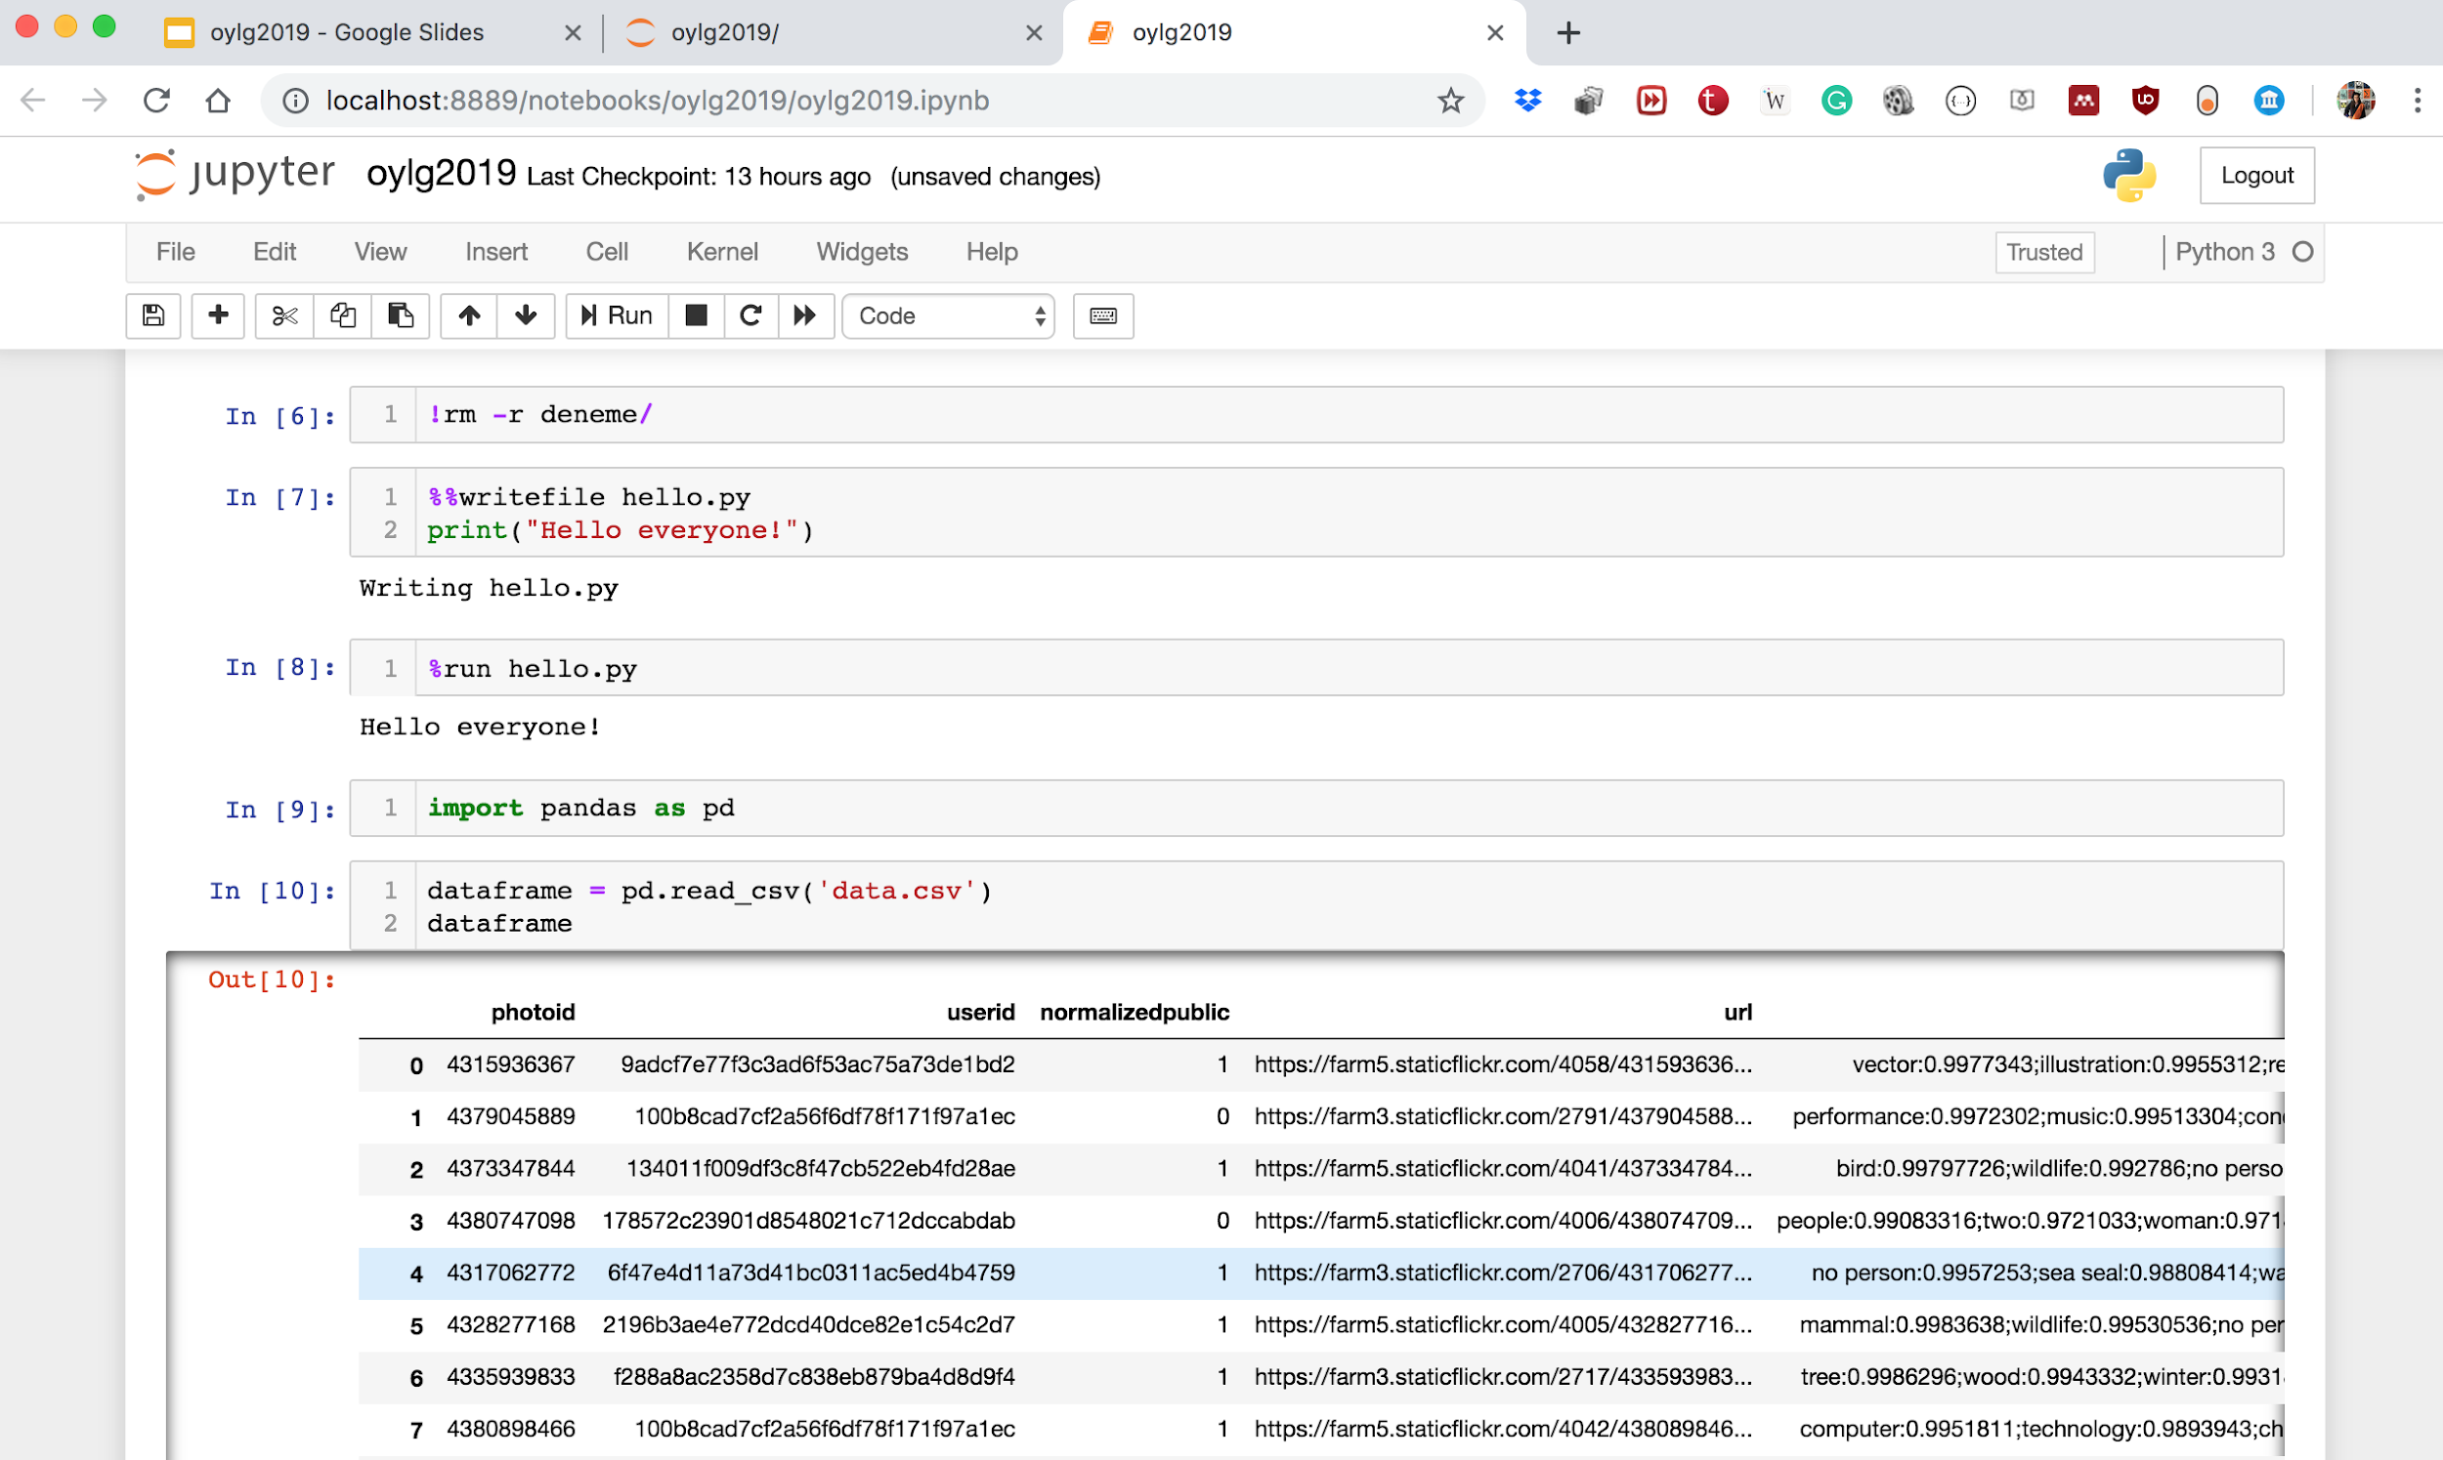

Slide 13
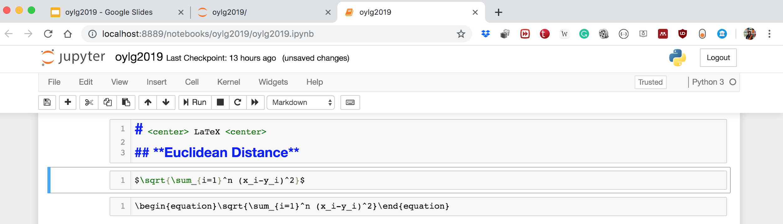

Slide 14
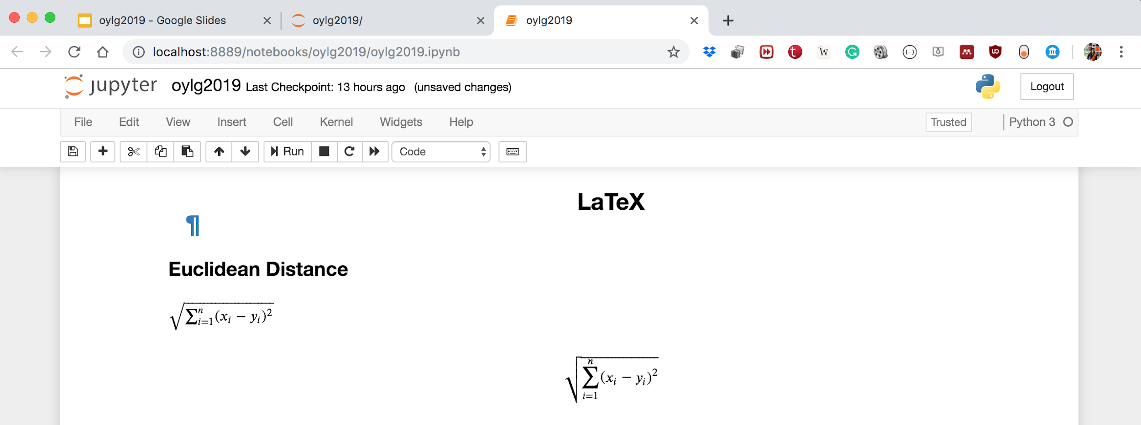

Slide 15

Word2Vec
Gönül Aycı - Bogazici University

Slide 16

Tomas Mikolov
Czech Computer Scientist
2013 @ Google
One of the most popular technique to learn word embeddings using two-layer neural networks
Vector Representations of a Word
Word Embedding
Word2Vec
Gönül Aycı - Bogazici University
Notes:
Word embedding: words or phrases from the vocabulary are mapped to vectors of real numbers

Slide 17
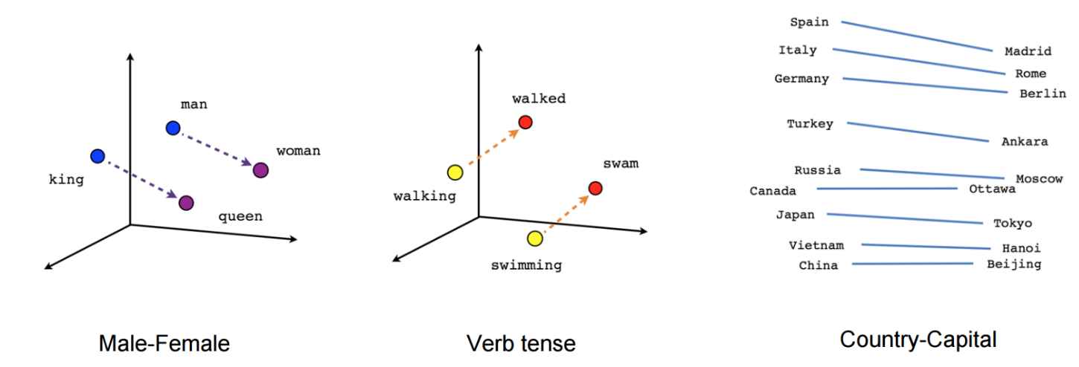
Word2Vec
Gönül Aycı - Bogazici University

Slide 18
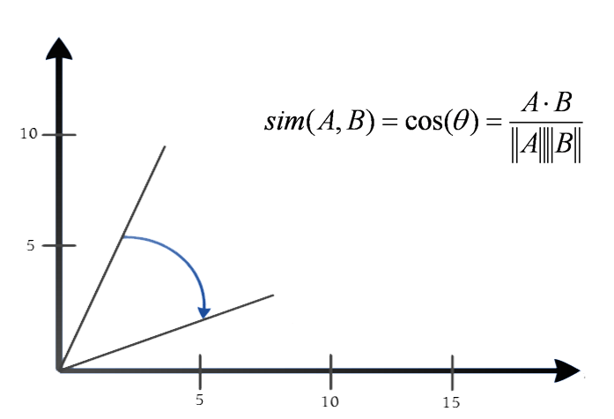


Cosine Similarity
Gönül Aycı - Bogazici University

Slide 19
DEMO: Word2Vec
Gönül Aycı - Bogazici University

Slide 20
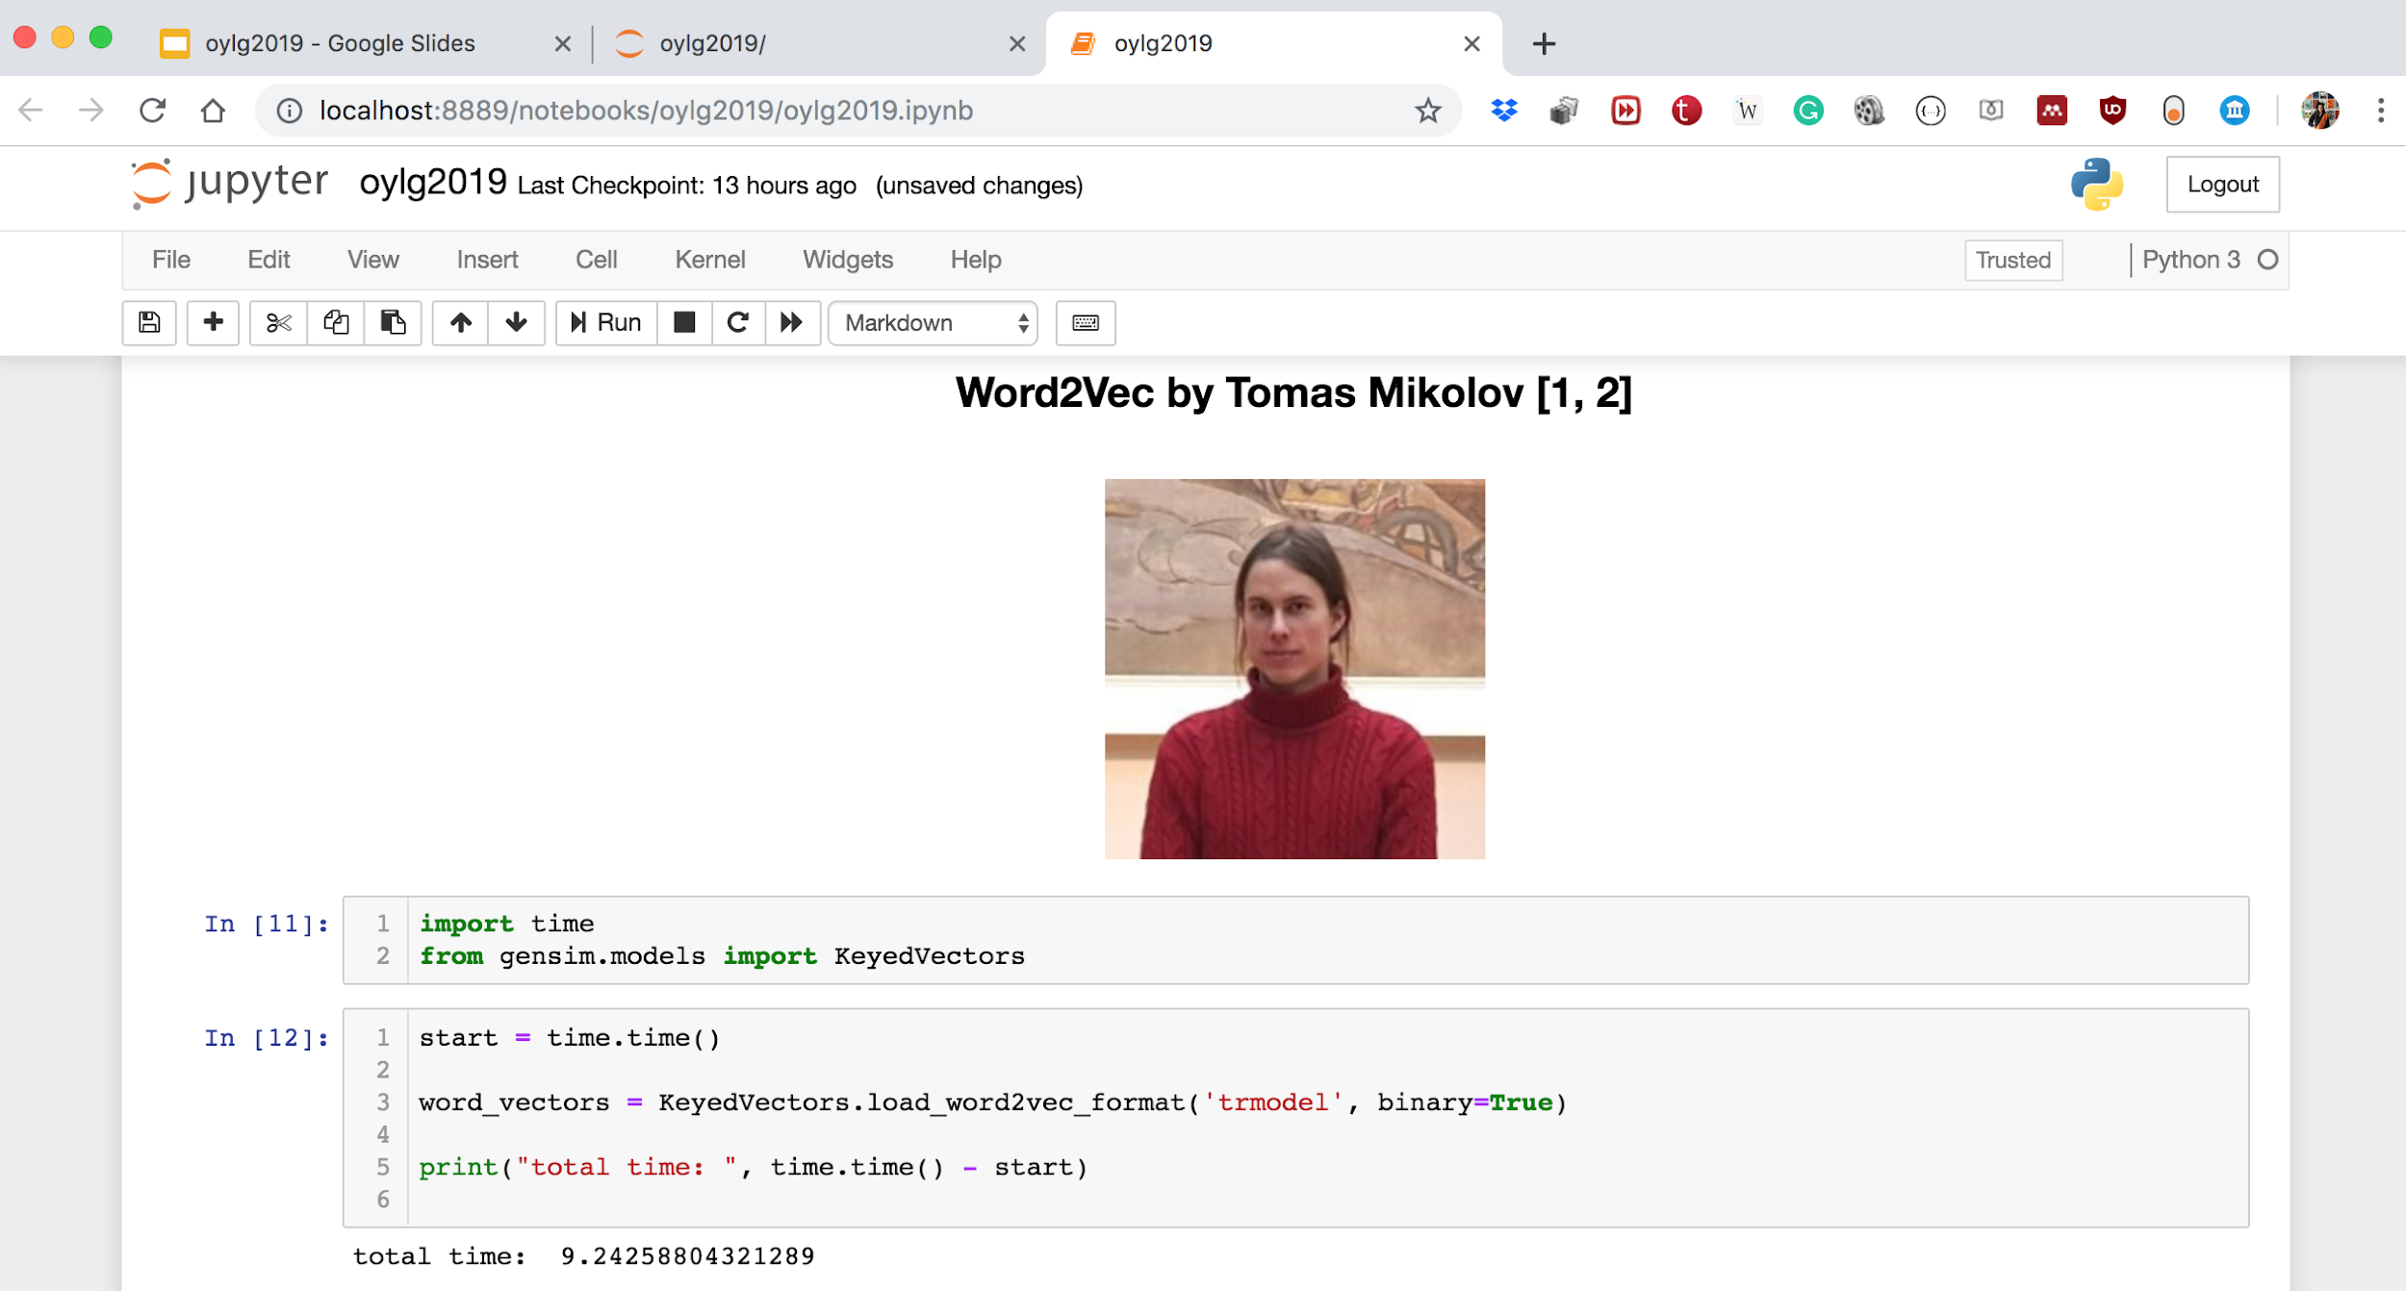

Slide 21
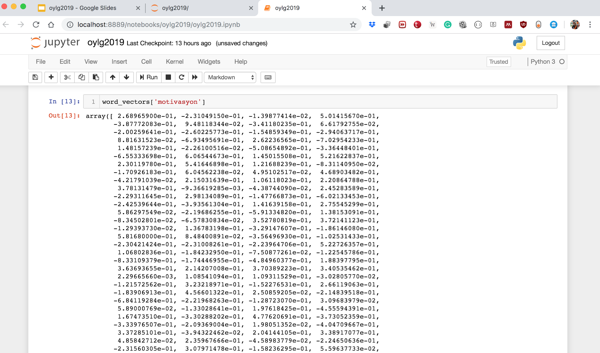

Slide 22
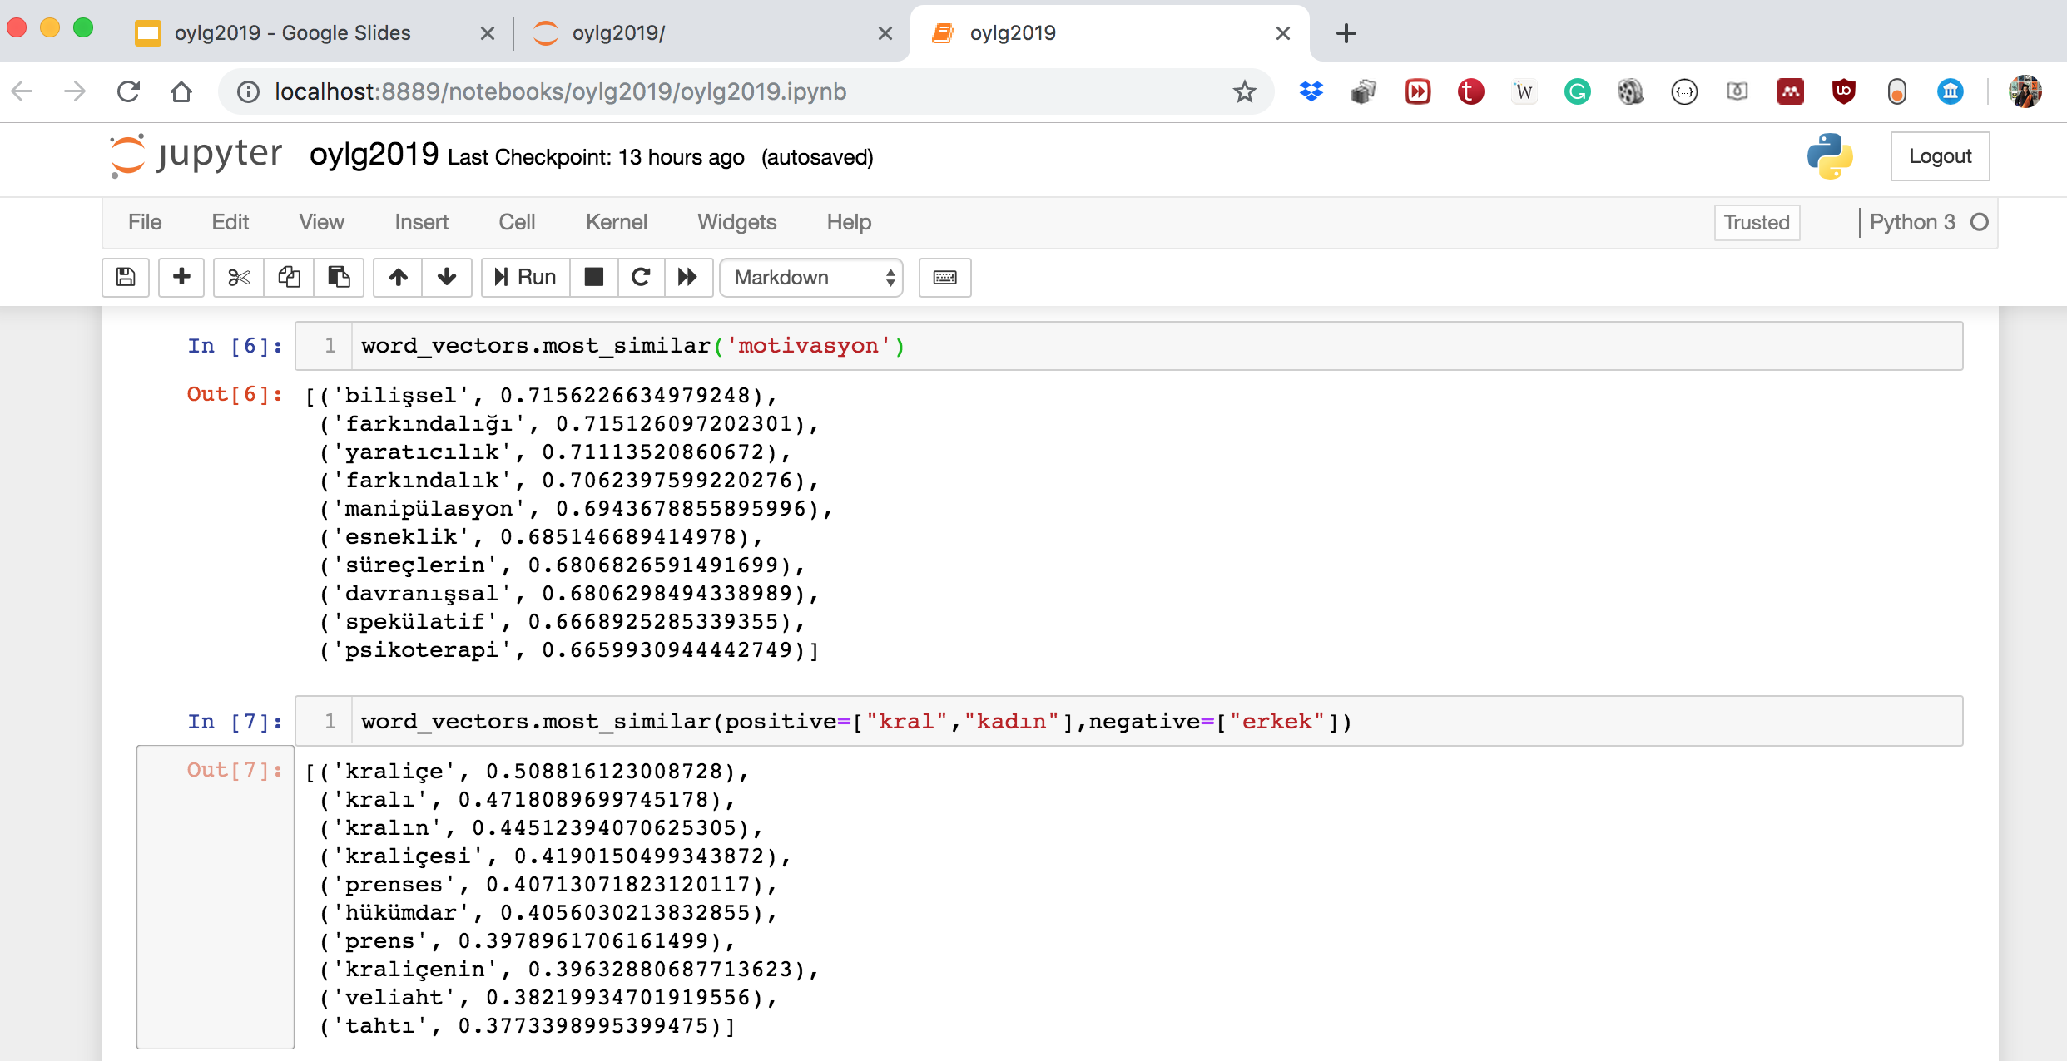

Slide 23
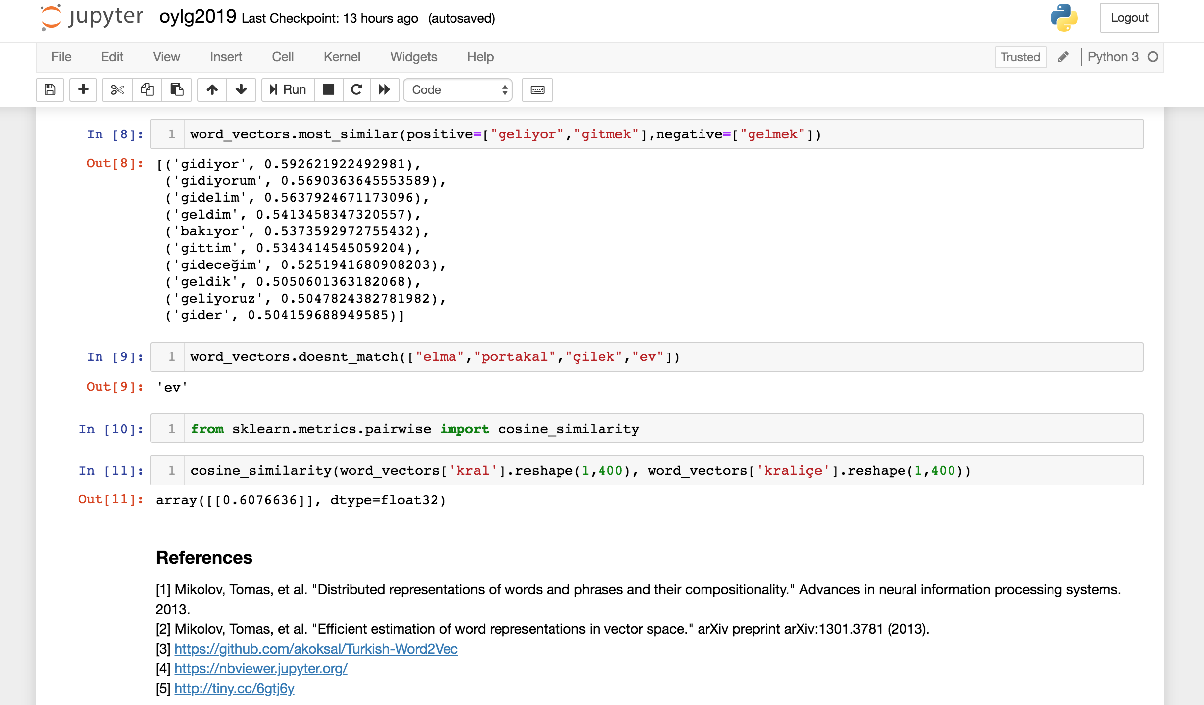

Slide 24
References
https://nbviewer.jupyter.org/
http://tiny.cc/jbvj6y
Mikolov, Tomas, et al. "Distributed representations of words and phrases and their compositionality." Advances in neural information processing systems. 2013.
Mikolov, Tomas, et al. "Efficient estimation of word representations in vector space." arXiv preprint arXiv:1301.3781 (2013).
Word2Vec Turkish: https://github.com/akoksal/Turkish-Word2Vec
Word2Vec English: https://nlp.stanford.edu/projects/glove/
http://tiny.cc/6gtj6y
Gönül Aycı - Bogazici University

Slide 25





aycignl
gonul_ayci
aycignl
Thank You For Listening Any Questions?
Gönül Aycı - Bogazici University

